Slide 1



?
Team : XKL

Slide 2

Contents
?
1. General Idea
2. Descriptive Analysis
3. Review (Text) Analysis

Slide 3



General Idea
Descriptive Analysis
Review (Text) Analysis
?
Make yourself visible Online!
Yelp
Google
Trusted Shop
Reevoo
Notes:
Nowadays, we often say that it is very important to make yourself “Visible” online no matter what we do. When it comes down to doing your own business, it becomes more important. There are many online platforms that could help business users such as Yelp, Google Map, Trusted Shop, Reevoo, and such. There are 173 million users in Yelp. And

Slide 4
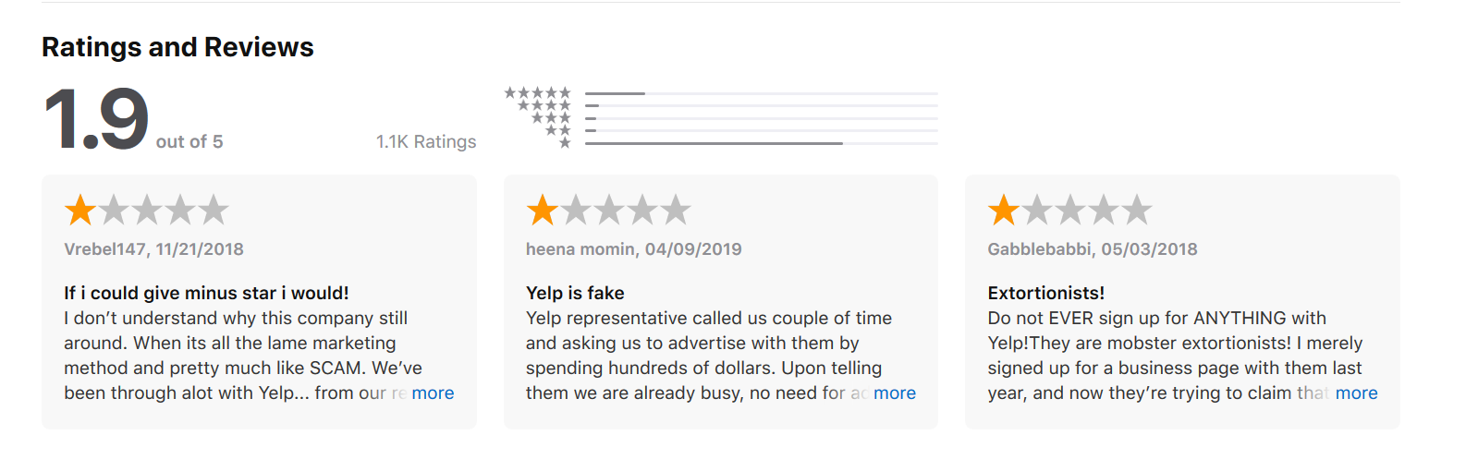
General Idea
Descriptive Analysis
Review (Text) Analysis
?
Notes:
Nowadays, we often say that it is very important to make yourself “Visible” online no matter what we do. When it comes down to doing your own business, it becomes more important. There are many online platforms that could help business users such as Yelp, Google Map, Trusted Shop, Reevoo, and such. There are 173 million users in Yelp. And

Slide 5
General Idea
Descriptive Analysis
Review (Text) Analysis
?
Raise a Question!
?
How helpful is Yelp
in terms of Business
Notes:
However, there’s an unanswered question: “How helpful are they?” in terms of maintaining the busiess?

Slide 6
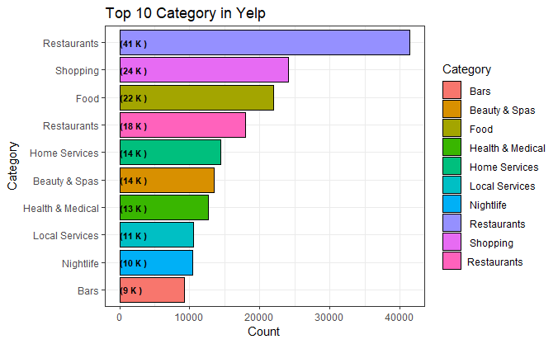
Descriptive Analysis
Review (Text) Analysis
General Idea
?
Unanswered Questions:
Notes:
However, there’s an unanswered question: “How helpful are they?” in terms of maintaining the busiess?

Slide 7
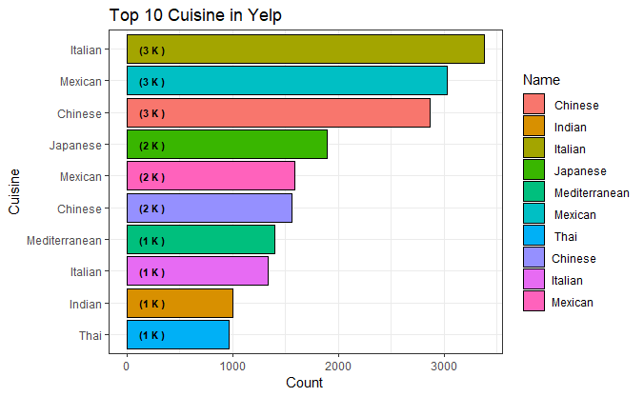
Descriptive Analysis
Review (Text) Analysis
General Idea
?
Unanswered Questions:
Notes:
However, there’s an unanswered question: “How helpful are they?” in terms of maintaining the busiess?

